Slide 1
West Midlands Branch
16/10/24

Slide 3
Branch Update
Thank you for your attendance and welcome to new members
Next Event 18/12/24 - Capsticks or Dudley Institute
MMUH tour now January - date to follow
Login to watch timelapse for MMUH available
Looking for comms to HEJ
Whatsapp Communities - Set up in Nov 24
Promoting membership to SMEs
Bring a friend to meetings
Coaching and Mentoring

Slide 4
National Update
Attendance to National Conference and will circulate the media pack
Conference talks to Branch /National level
IHEEM website updated for our branch and is a great source of info
Claire/Andy - any update

Slide 5
Introductions
IPA Midlands Professional Networks Community
Marc Stone
Steve Lawley
Nick Iliff

Slide 8
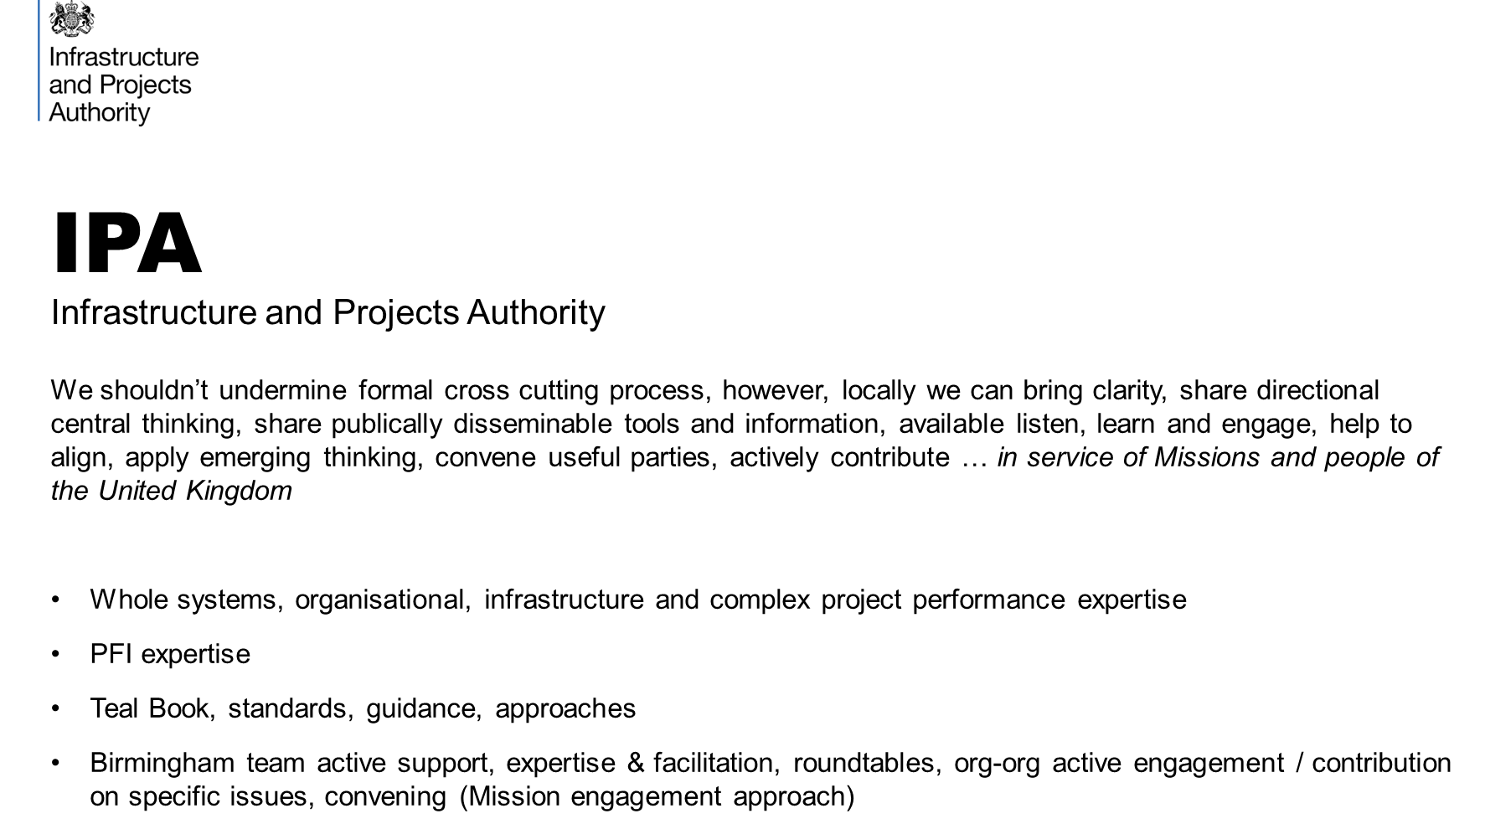

Slide 9
IPA Connection to Health PFI
IPA PFI Centre of Excellence
DHSC PFI Unit
NHSE Estates - Capital and Commercial Team
NHSE Regional Team
Integrated Care Boards
NHS Trusts

Slide 10
The IPA PFI Centre of Excellence
Carbon Net Zero guidance
Asset Condition surveys (3 to 6)
Insurance guidance
Distressed projects guidance
Annual data publication
White Fraiser recommendations response and implementation
Stakeholder engagement working groups
Future services guidance
Programme Level
Facilitated PFI contract expiry courses
Complete 68 Expiry Health Checks covering 77 projects
Contract management e-learning
Project 3: Building Capability
Project 1: Contract Expiry
Complete Asset Condition Playbook
SRO / senior official PFI learning pack
EHC refresh & learnings report
PFI Contract Management Programme
LG engagement and communication
PFI expert advice
Project 4: Expert Advice & Support
Project 2: Improving Operational Performance
Complete 5-7 OPHCs
Policy, Classification & HMT Approvals
Advice & support system
Contract management guidance and tools

Slide 11
Real Operational Challenges
Significant construction defects and compliance issues being identified (e.g. fire-safety, ventilation and cladding)
Most projects are outside of the original construction contractor’s liability period, therefore rectification liabilities often sit with thinly capitalised SPVs
Example: a PFI hospital with rectification costs equivalent to c.50% of the original build cost (£200m+)
Public sector budgets under pressure. Private sector perception that authorities are using aggressive contract management to reduce PFI liabilities
Public sector frustration at failure by private sector to address defects and performance issues
“Without intervention..the current trend towards increased disputes and deteriorating relationships [will] accelerate” (White Fraiser Report)
Construction Defects
Behaviours & Disputes
Demanding operating environments (e.g. acute hospitals operate at 100% capacity, 24/7) have challenged FM service providers
Historic under-reporting of performance issues by private sector and lack of public sector monitoring
Complex contractual relationships, with multiple parties
Example: a small NHS Trust paying £1m per year for 24/7 ‘fire walkers’ to mitigate fire risks and keep wards open
Service Failures
Resourcing & Skills
Under-resourcing of contract management on all sides.
FM providers report difficulty in in hiring and retaining staff with the right skills and capabilities, especially for “toxic” contracts
“30% of [contracting authorities] in our survey anticipate not having enough staff to manage the expiry process” (NAO: Managing PFI assets and services as contracts end)

Slide 12
What would help you post event ?
IPA | IHEEM
Provide list of contacts for NHSE Regional Team Direction to free available training from GCF and IPA Reach out for volunteers to review new guidance material and test new toolkits FAQ to go for help by subject | Send post event evaluation Joint IHEEM /NHSE local workshops for PFI and capital projects

